Slide 1
High-Dimensional Classification with PCA
STAT 6348 Final Project
Carolyne Chepkemboi
Jadon Guthrie
Willow Teaney

Slide 2
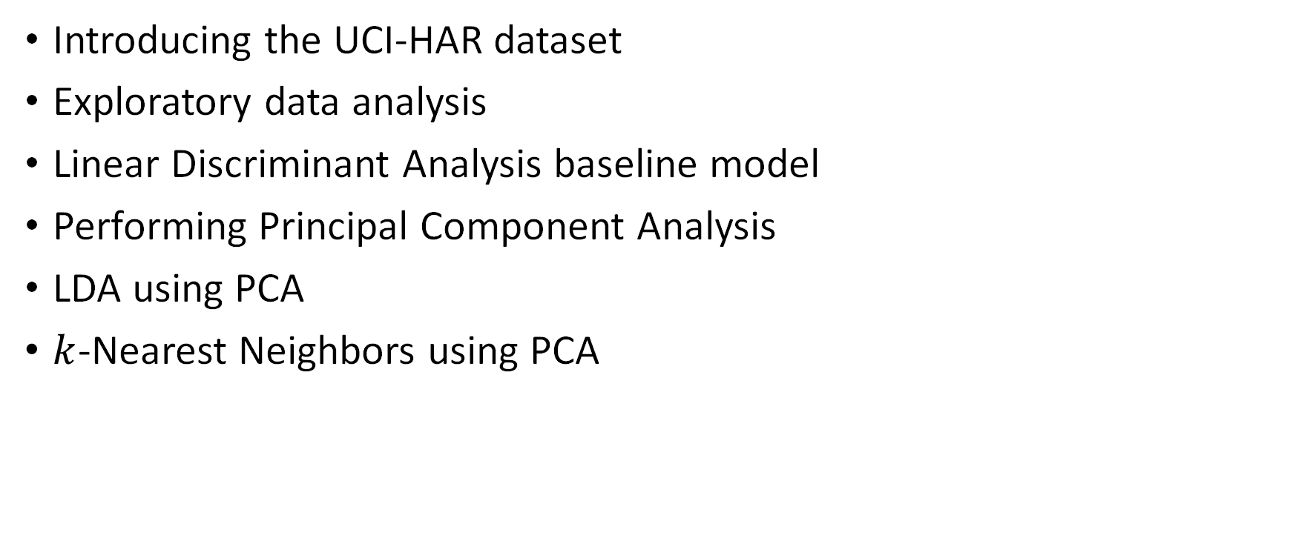
Presentation Structure
Introducing the UCI-HAR dataset
Exploratory data analysis
Linear Discriminant Analysis baseline model
Performing Principal Component Analysis
LDA using PCA
$k$-Nearest Neighbors using PCA

Slide 3
Dataset
Samsung Galaxy S II accelerometer and gyroscope signals
Strapped to the waist of participants, who performed 6 different activities
  Walking forwards, walking upstairs, walking downstairs
  Laying down, sitting down, standing up
561 features
7352 training observations, 2947 test observations (70-30 split)
Goal is to determine the activity performed using only statistics derived from the sensor signals

Slide 4
Anatomy of a Feature
Time Domain
Accelerometer
Signal Entropy
tBodyAccJerk-entropy()-Y
Body Component
Jerk Signal
Y-axis
“Jerk signal entropy of the accelerometer’s Y-axis body component”

Slide 5
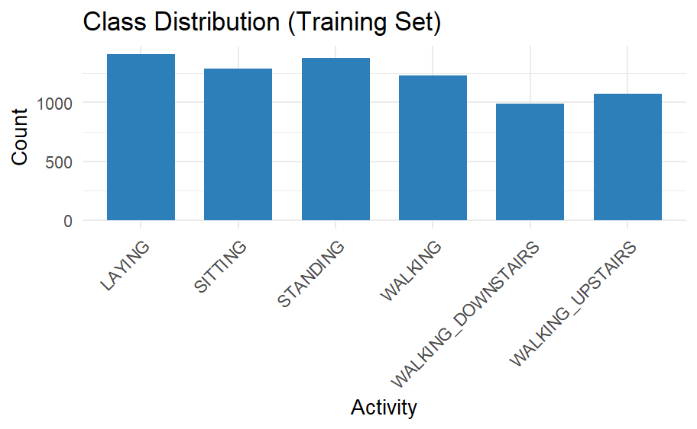
EDA: Class Distribution of Activities
Key Observations
Classes are approximately balanced
No dominant or rare class
Slight variation across activities
Accuracy is a reliable evaluation metric

Slide 6
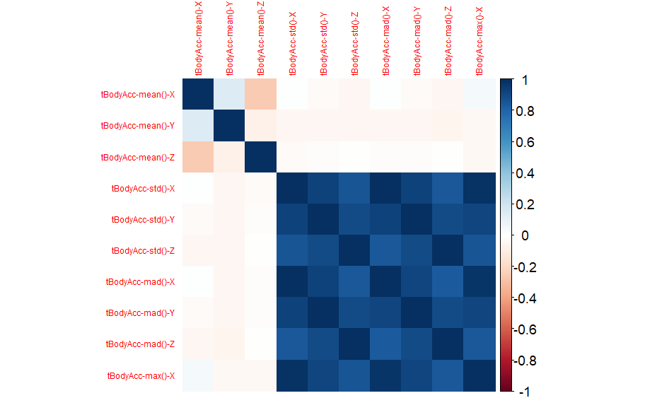
Correlation Heatmap (10 out of 561 features)
Key Observations
Strong positive correlations among variability features
(e.g., std, mad, max)
Mean features show weaker correlations
Interpretation
Many features are highly redundant
Dataset exhibits multicollinearity
High dimensionality does not imply independent information
Motivates the use of PCA for dimensionality reduction
Reduce redundancy while preserving key structure

Slide 7
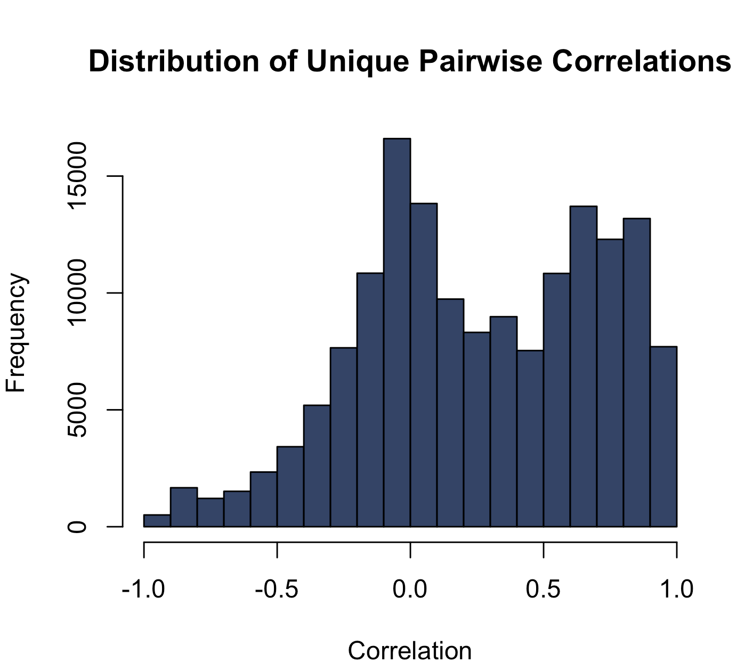
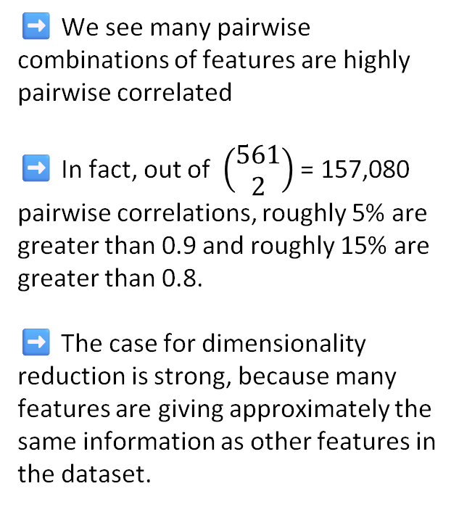
Pairwise Correlations Distribution
➡️ We see many pairwise combinations of features are highly pairwise correlated
➡️ In fact, out of $\left(\begin{matrix}561 \\ 2\end{matrix}\right)$ = 157,080 pairwise correlations, roughly 5% are greater than 0.9 and roughly 15% are greater than 0.8.
➡️ The case for dimensionality reduction is strong, because many features are giving approximately the same information as other features in the dataset.
‎
‎

Slide 8
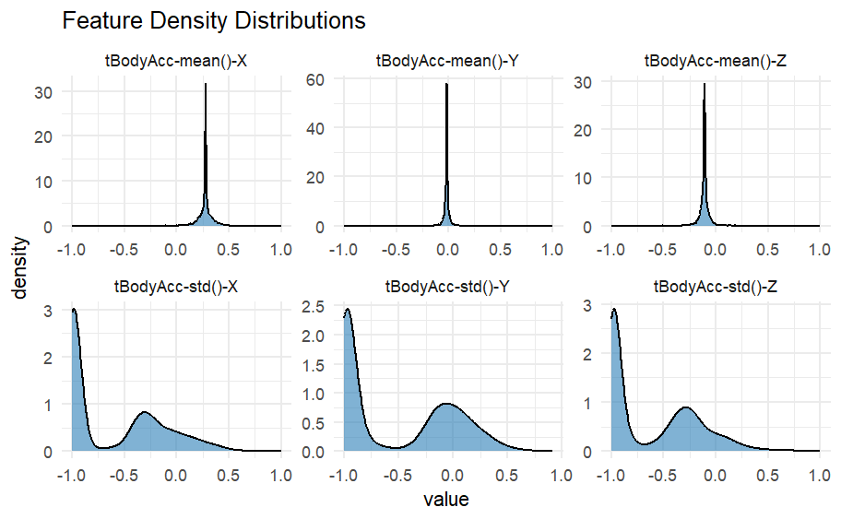
Features are bounded to [-1, 1] but distributions differ widely in shape and spread
Mean features are zero-inflated; std features are left-skewed near –1
Standardization (mean=0, sd=1) is required before applying PCA
apply sweep() on training data to avoid data leakage

Slide 9
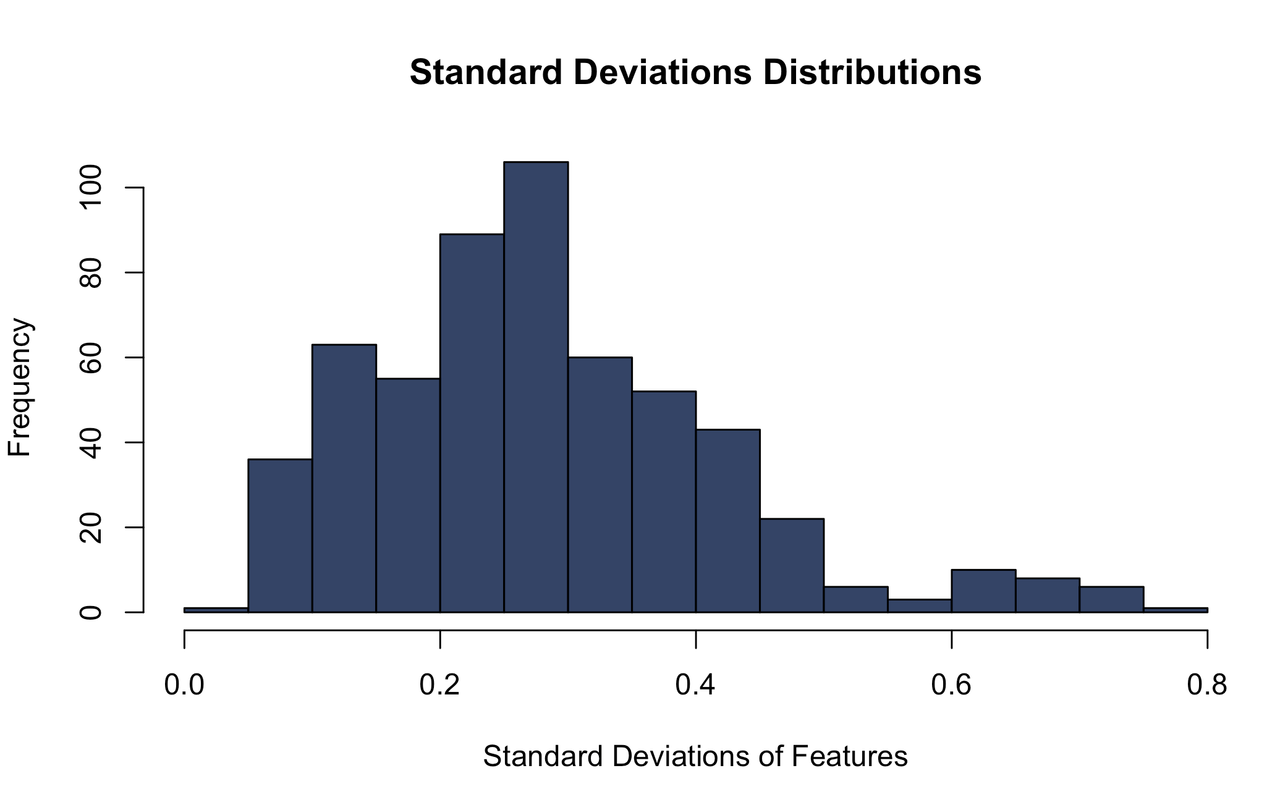
Why We Standardize
The features have noticeably different standard deviations, meaning they exist on different scales.
Higher variance features will be given more influence in PCA because PCA prioritizes the highest variance directions.
Standardization prevents high variance features from dominating the component analysis.

Slide 10
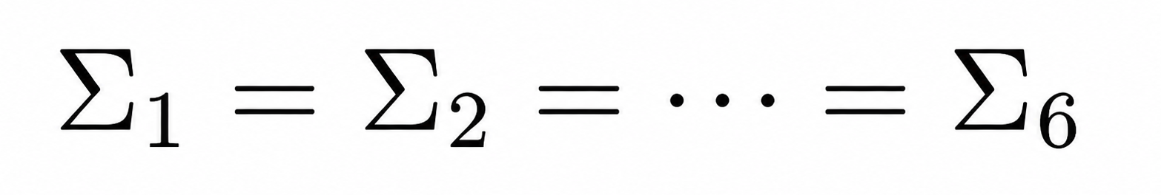
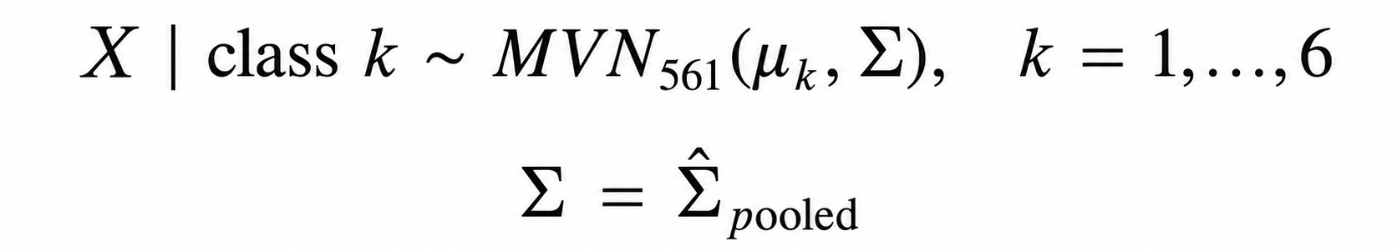
Introduction to LDA
Assumption: Class specific distributions follow MVN distributions with equal variance-covariance matrices:
In practice, we compute a pooled estimator for the common covariance matrix.
We compute a discriminant score for each observation in the test set for each class using class-specific sample mean vectors and the pooled covariance matrix of the scaled training set.
We assign an observation to a class with the highest discriminant score.
Equal covariance assumption forces a linear decision boundary in high dimensional space.

Slide 11
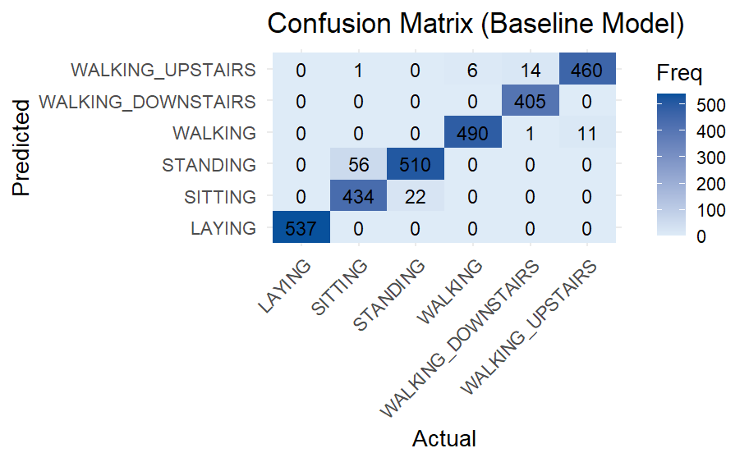
Baseline LDA Confusion Matrix
High baseline performance on test set, indicative of high quality and nearly linearly separable data.
The model learned to generalize well to unseen data, only seeing a few misclassifications in four out of the 6 categories.
Baseline accuracy = 0.962
​Curse of dimensionality: despite having 561 features, data sparsity does not lead to poor predictive accuracy.

Slide 12
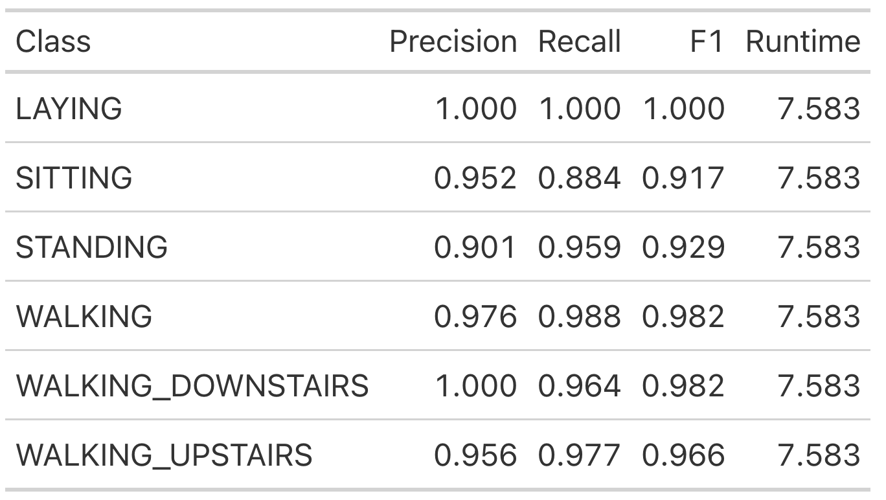
Baseline LDA Performance Metrics
We see precision of 0.9 or greater for all classes: predicted classes tend to be right. For "LAYING" and "WALKING_DOWNSTAIRS", LDA predicts the right class 100% of the time.
Recall is also strong across the board, indicating that the model finds most of the observations belonging to each respective category.
Goal of PCA: Can we substantially improve efficiency without much loss in quality?
​
​
Applications: Allowing smartphone fitness apps to process sensor data more efficiently by reducing the number of features while retaining most of the predictive power. This carries the potential to save battery life while lowering application processing cost and latency.

Slide 13
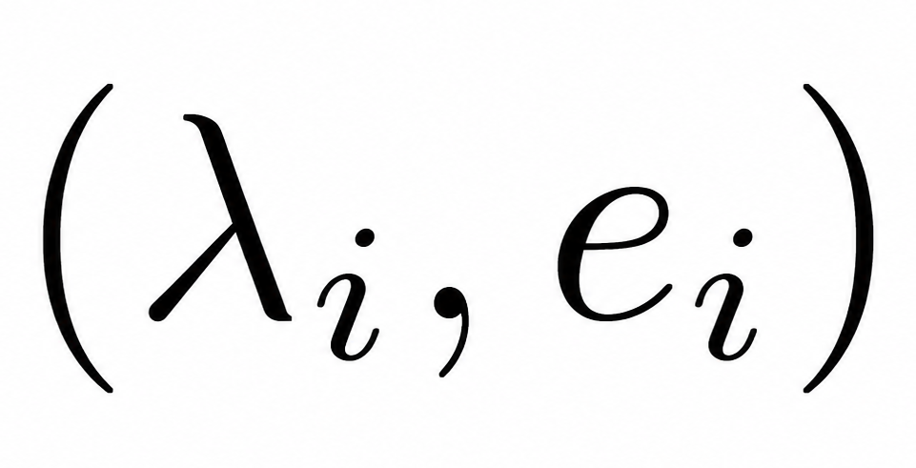
Introduction to PCA
Find the covariance matrix of the standardized data.
Compute eigenvalue, eigenvector pairs of the covariance matrix.
Sort eigenvalue, eigenvector pairs in descending order by eigenvalue.
Choose the first n components that preserve the desired proportion of variance explained.
Transform the data by projecting it onto the selected eigenvectors using linear combinations.

Slide 14
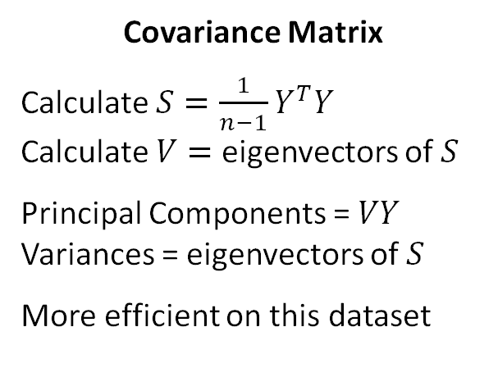
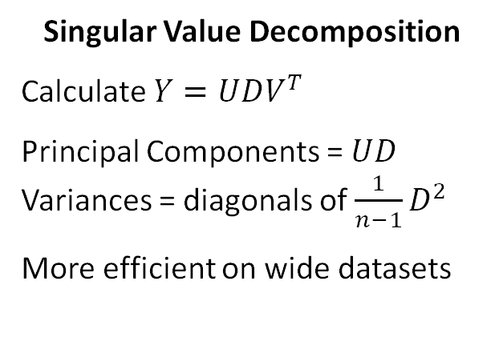
Performing PCA Efficiently
Covariance Matrix
Calculate $S=\frac{1}{n−1}Y^{T}Y$
Calculate $V=$ eigenvectors of $S$
Principal Components = $VY$
Variances = eigenvectors of $S$
More efficient on this dataset
Singular Value Decomposition
Calculate $Y=UDV^{T}$
Principal Components = $UD$
Variances = diagonals of $\frac{1}{n−1}D^{2}$
More efficient on wide datasets
Built-In Package
Use PCA() from FactoMineR
Computes additional results useful for analysis and building models
Time To Compute: ~2.5s
Time To Compute: ~5s
Time To Compute: ~5s

Slide 15
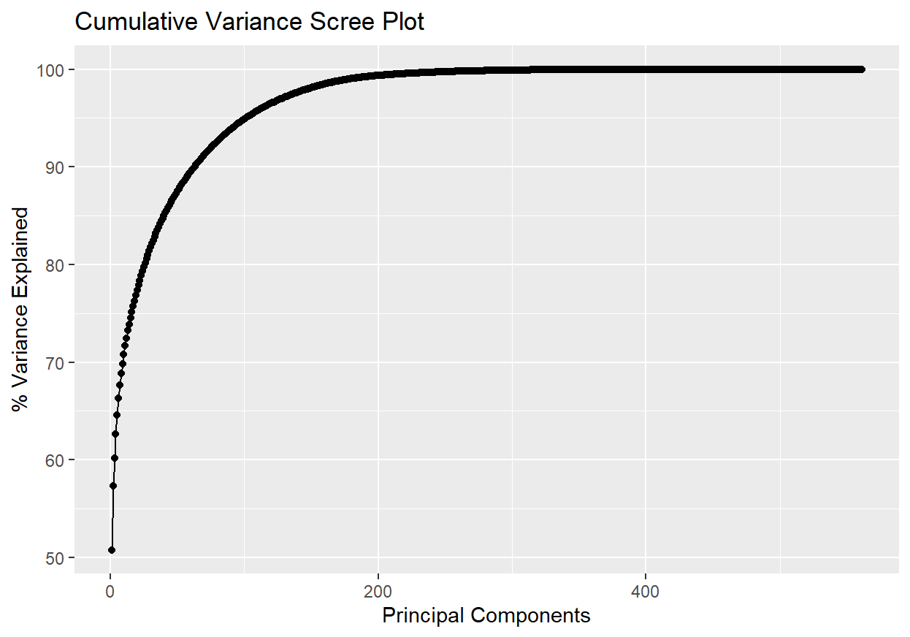
Cumulative Variance
Cumulative Variance Explained (%) | # of Principal Components
80% | 26
90% | 63
95% | 102
99% | 179
99.9% | 296
Cumulative Variance Explained (%) | # of Principal Components
50.78% | 1
64.56% | 5
70.82% | 10
77.37% | 20
87.52% | 50
94.89% | 100
99.36% | 200

Slide 16
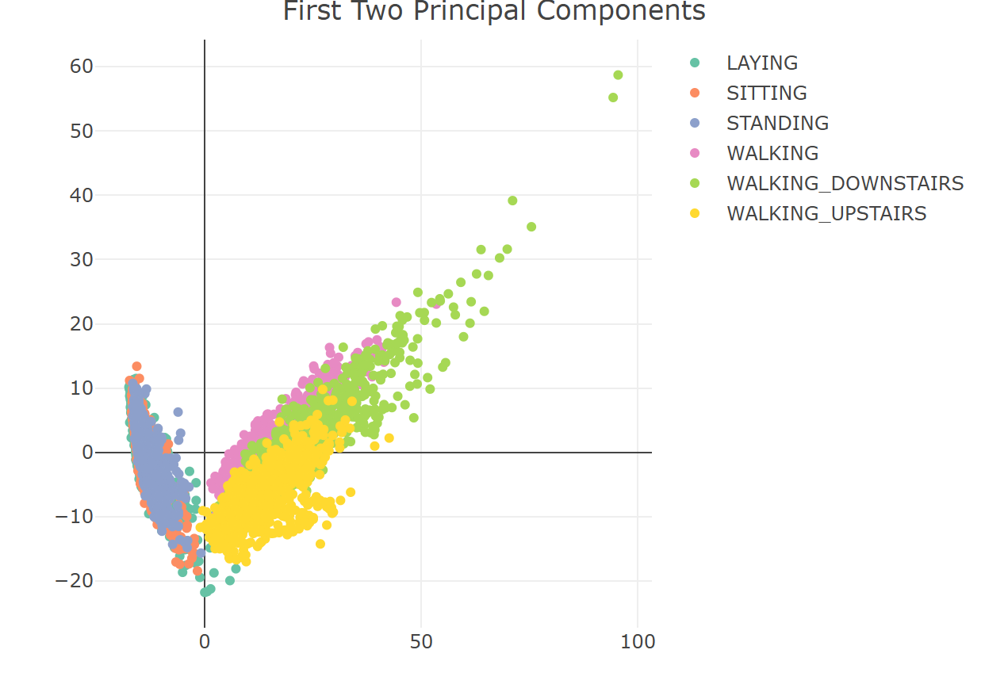
PCA Visualizations

Slide 17
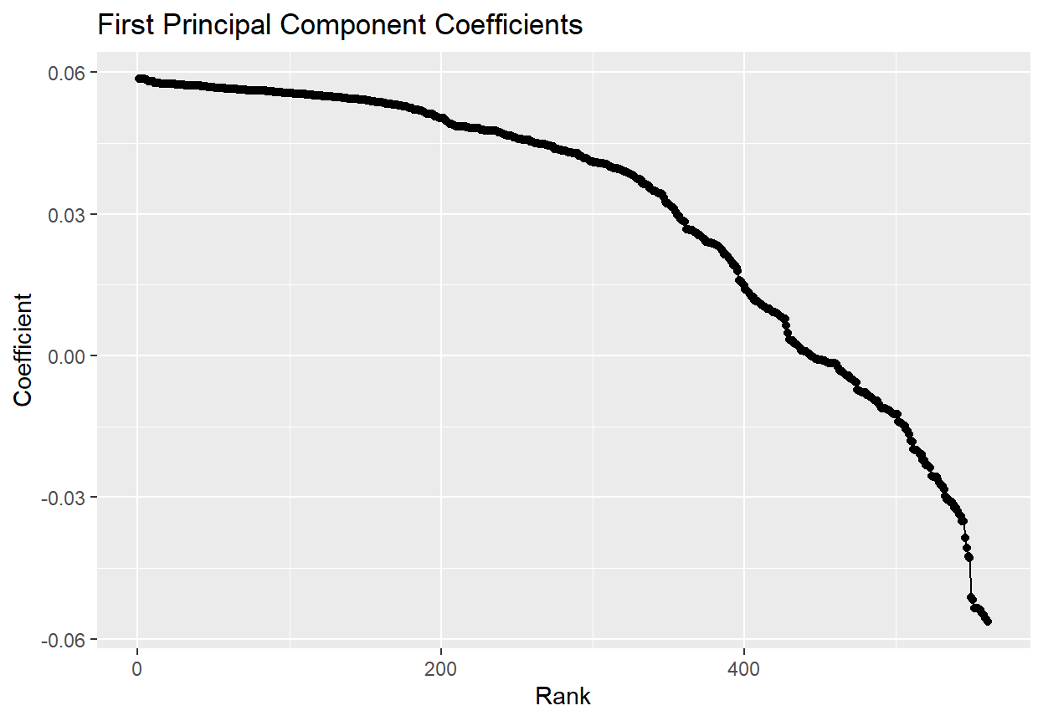
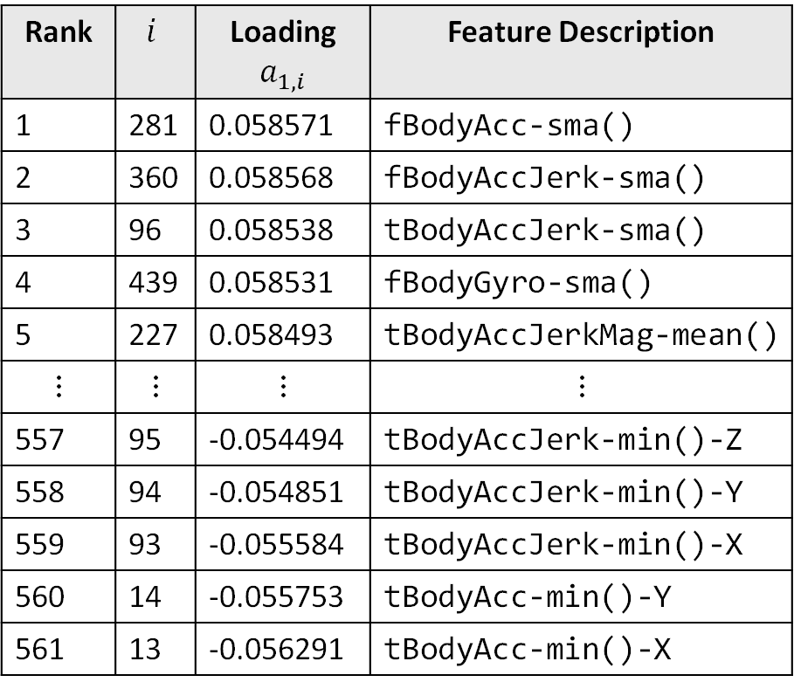
First Principal Component
Rank | $$i$$ | Loading$a_{1, i}$ | Feature Description
1 | 281 | 0.058571 | fBodyAcc-sma()
2 | 360 | 0.058568 | fBodyAccJerk-sma()
3 | 96 | 0.058538 | tBodyAccJerk-sma()
4 | 439 | 0.058531 | fBodyGyro-sma()
5 | 227 | 0.058493 | tBodyAccJerkMag-mean()
$$⋮$$ | $$⋮$$ | $$⋮$$ | $$⋮$$
557 | 95 | -0.054494 | tBodyAccJerk-min()-Z
558 | 94 | -0.054851 | tBodyAccJerk-min()-Y
559 | 93 | -0.055584 | tBodyAccJerk-min()-X
560 | 14 | -0.055753 | tBodyAcc-min()-Y
561 | 13 | -0.056291 | tBodyAcc-min()-X
Signify consistent accelerations and jerk
Signify spiky accelerations and jerk

Slide 18
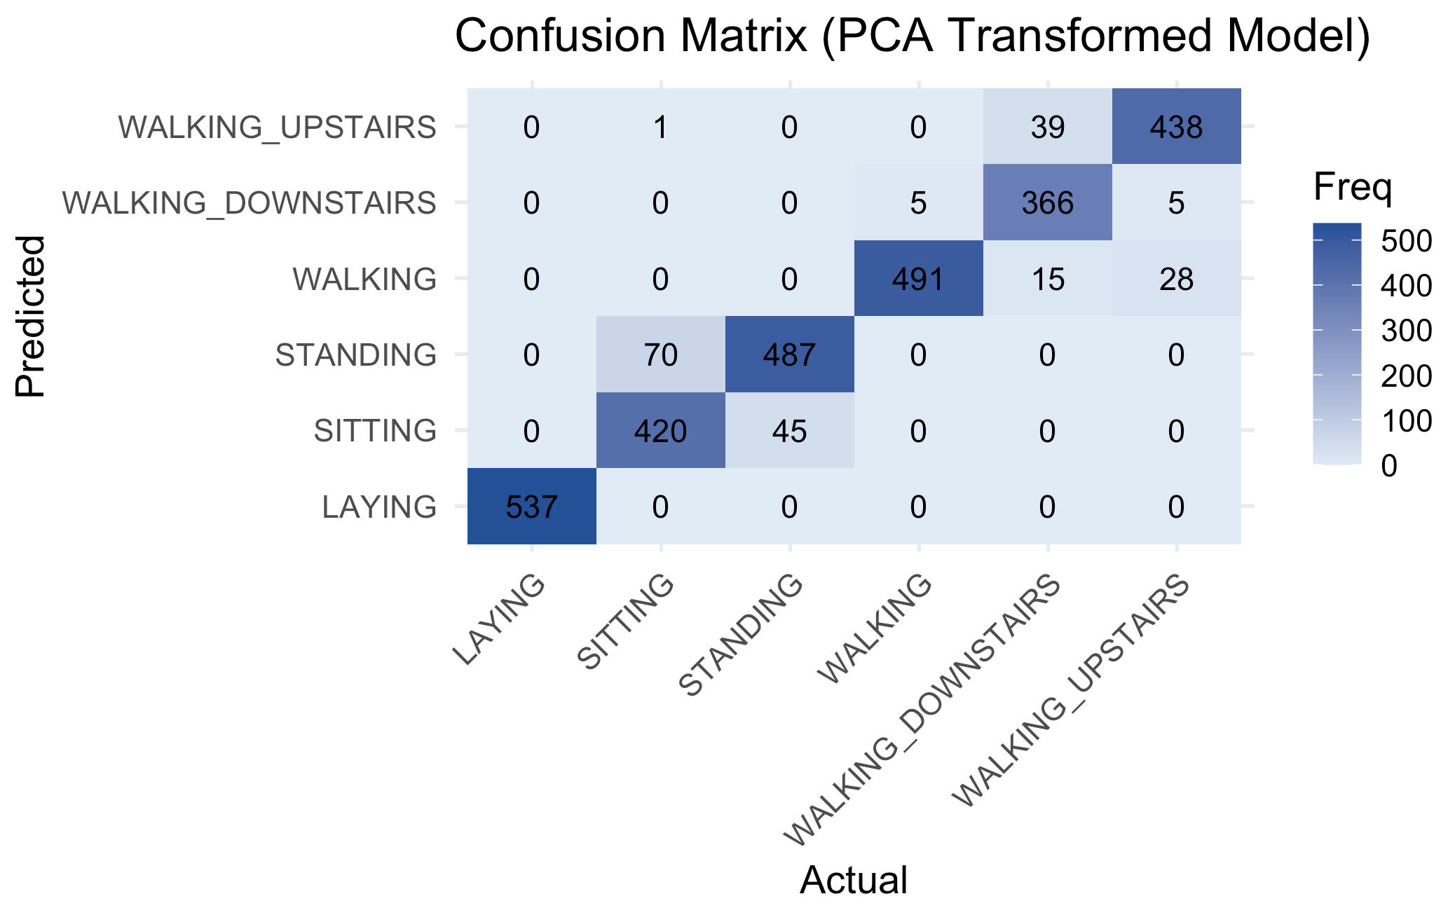
PCA Transformed LDA Confusion Matrix
102 Principal Components
More misclassifications on the test data, and more categories carry misclassifications than before.
Slightly worse generalization on the test set using only 18.18% as many features as the original.
PCA transformed accuracy = 0.929

Slide 19
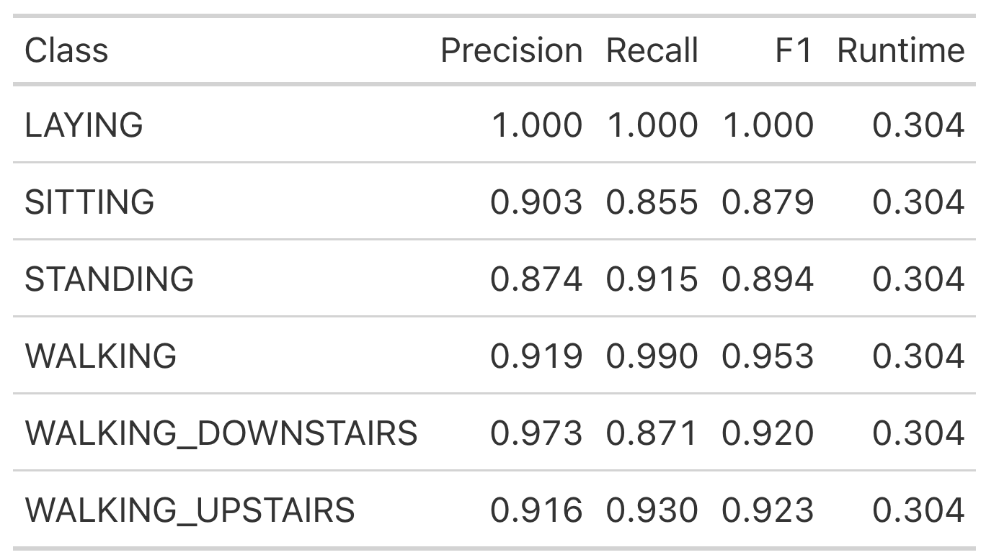
PCA Transformed LDA Performance Metrics
In comparison to the baseline, we predict correct classes and catch real observations of each a lower percentage of the time.
Loss in F1 as high as 6.2%, with a loss of 3.5% on average.
Enormous relative speedup of 95.99%, from ~7.6 seconds to ~0.3 seconds.

Slide 20
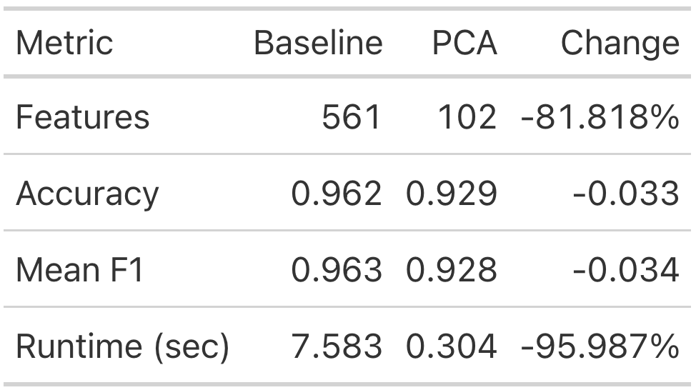
LDA Model Comparison
Dimension reduction pros:
Much faster, more suitable for highly granular motion data producing millions of observations per day or weaker hardware.
We only need to run PCA once and then can fit a suite of models reaping these benefits.
Dimension reduction cons:
Trade-off of lower generalization performance on unseen data.
Less suitable for motion data with fewer features, fewer correlated feature-feature pairs, and instances where lower accuracy can cause real harm (e.g. heart failure classification).

Slide 21
Dataset Implications
Recordings encode 3 axes of linear acceleration and 3 axes of angular velocity at 50 Hz.
As readings are made 50 times a second, extrapolated over an entire day this brings us to 50 x 60 x 60 x 24 = 4.32 million readings per day. With 6 recorded channels per reading, we have roughly 26 million values recorded per day.
Conclusion: PCA makes it feasible to perform repeated classifications on less aggregated, more granular by improving speed without a large reduction in prediction quality.

Slide 22
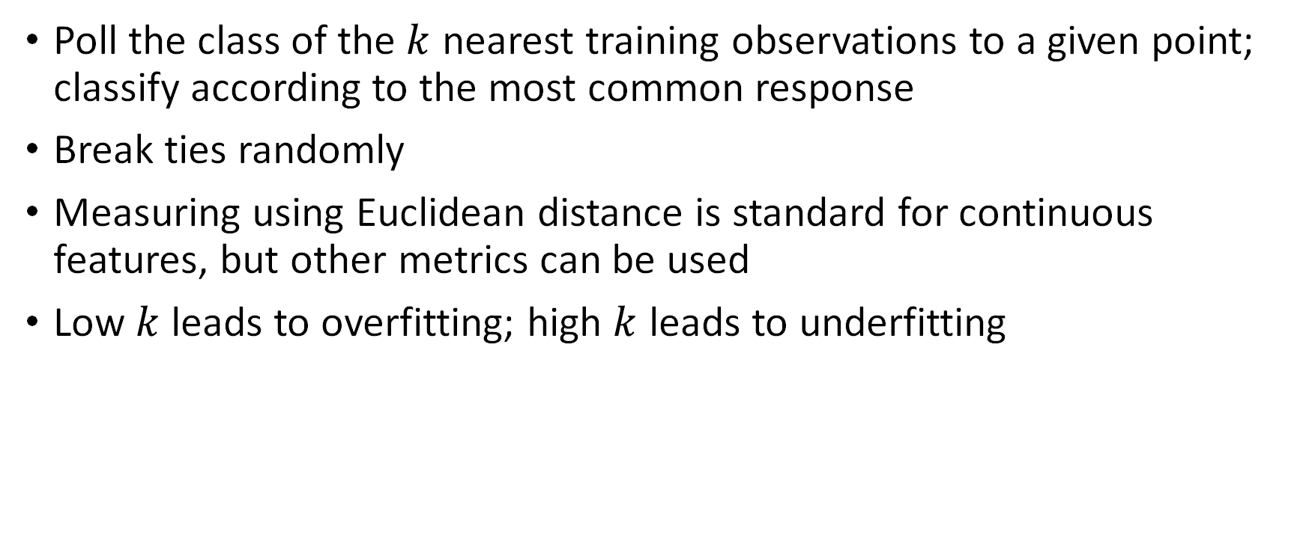

$k$-Nearest Neighbors Introduction
Poll the class of the $k$ nearest training observations to a given point; classify according to the most common response
Break ties randomly
Measuring using Euclidean distance is standard for continuous features, but other metrics can be used
Low $k$ leads to overfitting; high $k$ leads to underfitting

Slide 23
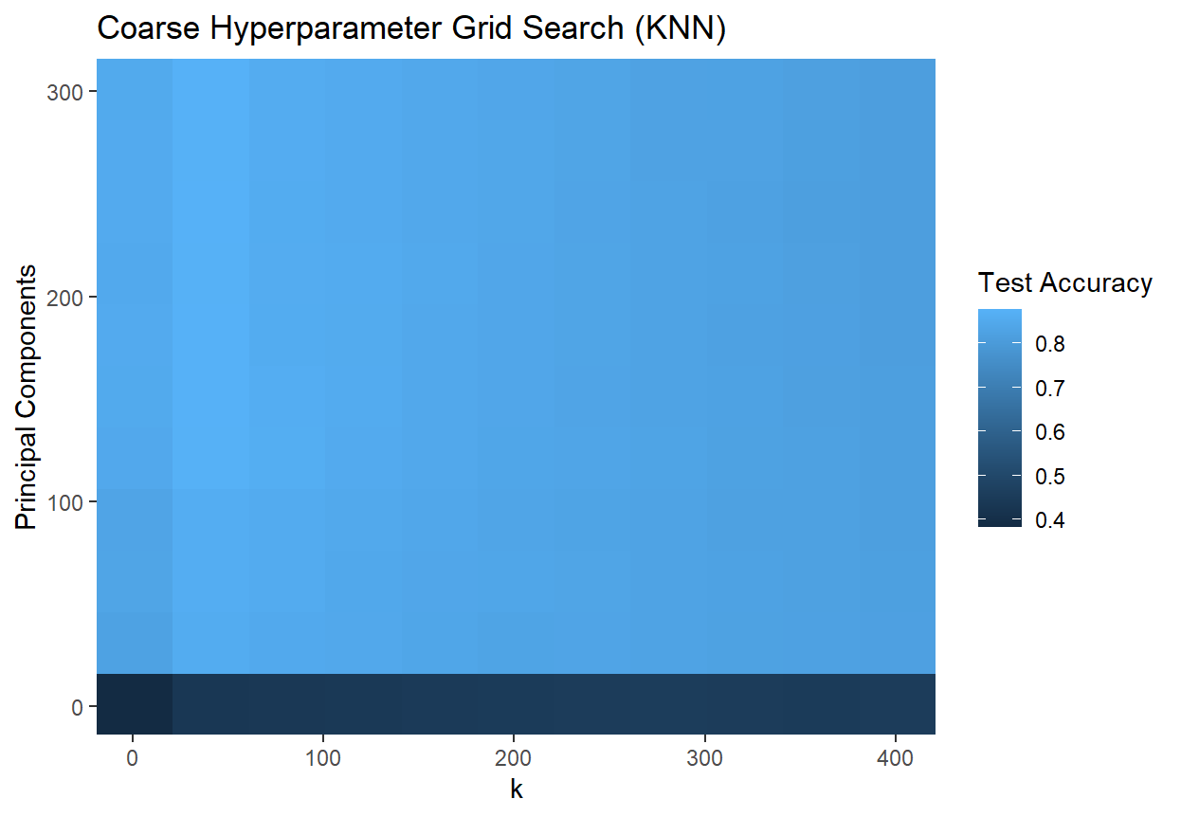

$k$-Nearest Neighbor Classification Tuning

Slide 24
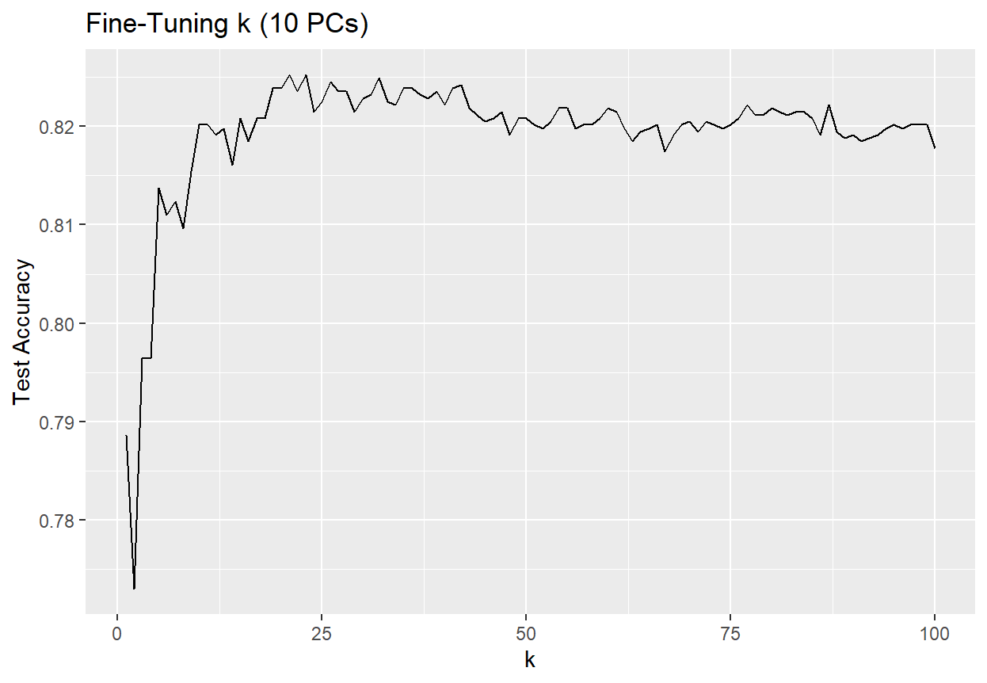
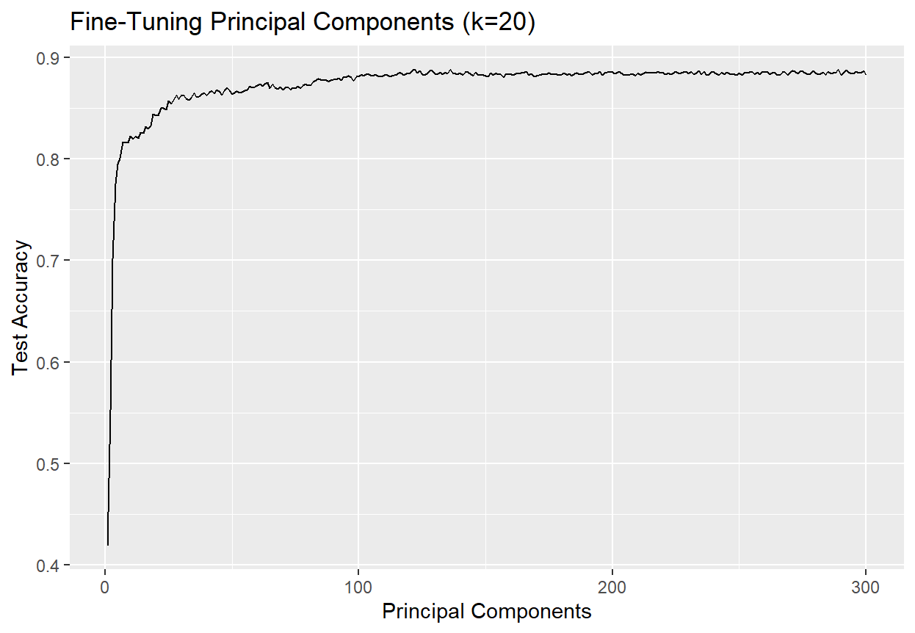
Independently Tuning Hyperparameters
$k$ = 20 and ≥ 120 principal components performs at ≈ 88.6% test accuracy, equal to the performance of $k$-NN on the original data set for the same $k$, and is ≈ 8.5x faster!

Slide 25
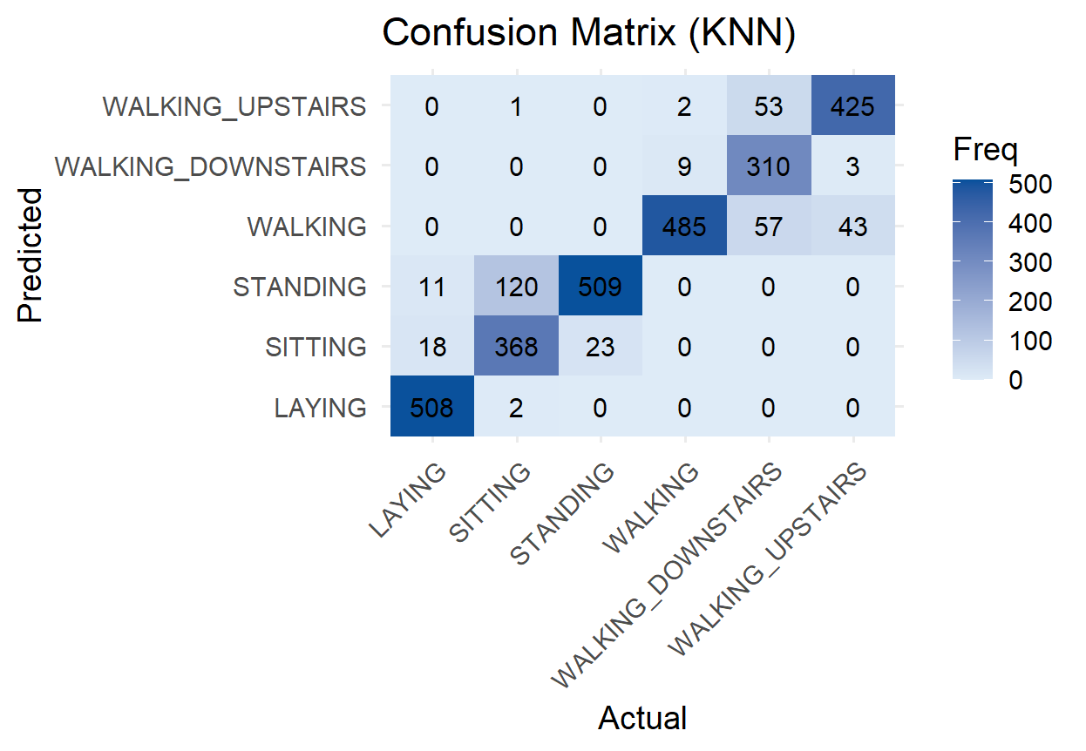

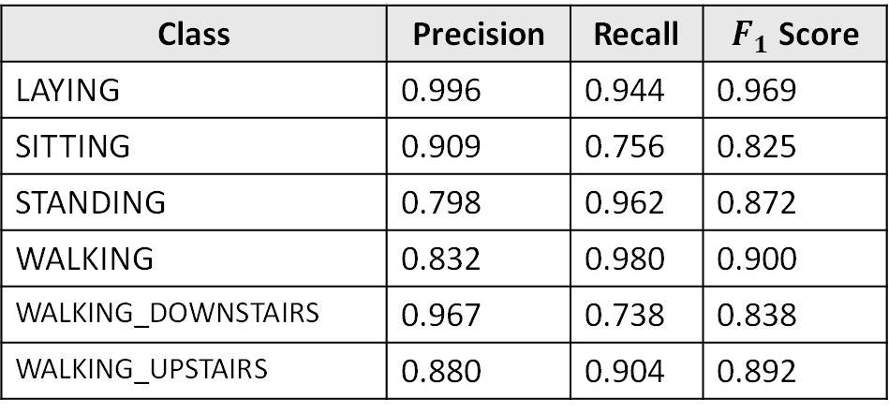
$k$-NN Evaluation ($k$ = 20, 125 PCs)
Accuracy | 0.886
Class | Precision | Recall | $F_{1}$ Score
LAYING | 0.996 | 0.944 | 0.969
SITTING | 0.909 | 0.756 | 0.825
STANDING | 0.798 | 0.962 | 0.872
WALKING | 0.832 | 0.980 | 0.900
WALKING_DOWNSTAIRS | 0.967 | 0.738 | 0.838
WALKING_UPSTAIRS | 0.880 | 0.904 | 0.892

Slide 26
References
Davide Anguita, Alessandro Ghio, Luca Oneto, Xavier Parra and Jorge L. Reyes-Ortiz. A Public Domain Dataset for Human Activity Recognition Using Smartphones. 21th European Symposium on Artificial Neural Networks, Computational Intelligence and Machine Learning, ESANN 2013. Bruges, Belgium 24-26 April 2013.

